Slide 1
Human resources slide 1
Student Management System
Database Management System Project
Submitted to
Anichur Rahman
Assistant Professor, Department of CSE
NITER

Slide 2
Human resources slide 2
TEAM INNOVATORS UNITE
Feroj Miah(CS-2102037)
Md Sohag Hossain(CS2102016)
Ashik Iqbal(CS-2102032)
Laboni Akter(CS-2102026)
Israt JahanCS-2102021)
Afia Tabassum(CS-2102023)

Slide 3
Human resources slide 2
AGENDA
Introduction
Motivations
Background Study
Literature Study
Problem Statement
Objectives
Method
System Design
Result Analysis
Conclusion
Limitation and Future Work
References

Slide 4
Human resources slide 9
INTRODUCTION
To the Student Management System
A Student Management System (SMS) is a software application designed to streamline the management of student-related data and processes within educational institutions such as schools, colleges, and universities. It serves as a centralized platform for administrators, teachers, students, and parents to access and manage various aspects of the academic lifecycle.

Slide 5
Human resources slide 3
EMPLOYEES ARE MOTIVATED BY:
The motivation behind our project stems from the increasing complexity of student data management in educational institutions. Traditional methods often involve manual paperwork and tedious administrative processes, leading to inefficiencies and errors. We recognized the need for a modern, digital solution to simplify these tasks and enhance overall productivity.
MOTIVATION

Slide 6
Human resources slide 5
In our background study, we researched existing student management systems and analyzed their features, strengths, and limitations. We examined how these systems are implemented in various educational settings to understand the diverse needs and challenges faced by administrators, teachers, and students.
BACKGROUND STUDY

Slide 7
Human resources slide 10
LITERATURE
STUDY
Our literature study involved reviewing academic papers, articles, and relevant publications on database management systems and educational technology. We explored current trends, best practices, and emerging technologies in the field to inform the design and development of our system.

Slide 8
Human resources slide 8
?
PROBLEM
STATEMENT
The problem we identified revolves around the inefficiencies and complexities associated with manual student data management processes. These include data inaccuracies, duplication of efforts, and difficulty in accessing and analyzing student information in a timely manner. Our goal was to address these challenges through the implementation of a comprehensive Student Management System.

Slide 9
Human resources slide 4
Designing a user-friendly interface for administrators, teachers, and students
Implementing robust data management functionalities to ensure accuracy and integrity
Providing real-time access to student information and performance metrics
Streamlining administrative tasks such as enrollment, grading, and attendance tracking
Enhancing communication and collaboration between stakeholders within the educational institution.
OBJECTIVES

Slide 10


Human resources slide 8
METHOD
To achieve our objectives, we adopted a systematic approach that involved:
System Design (ER Diagram Design)
ER Diagram to Relational Model
Database Code Implementation
Connect Database with the Application

Slide 11
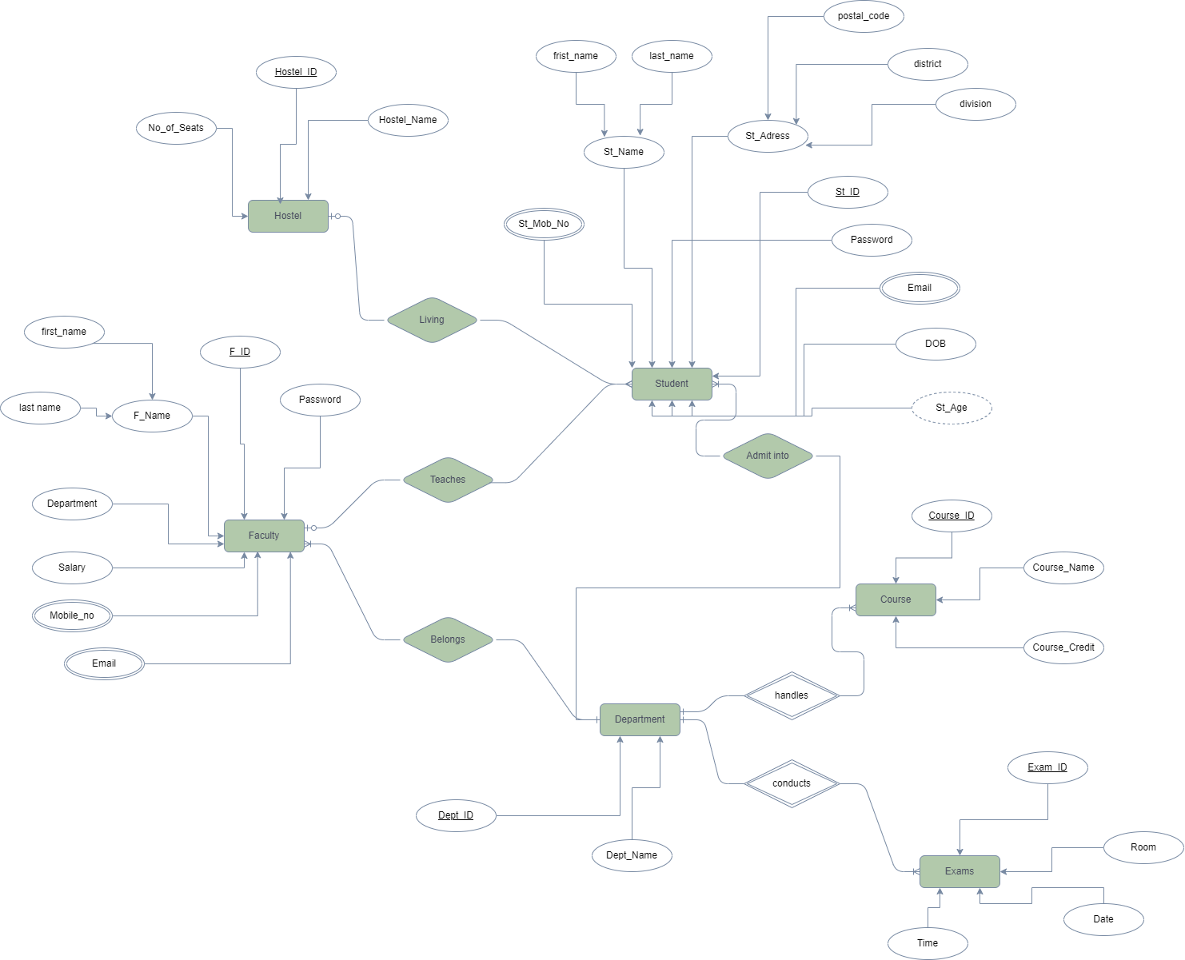
Human resources slide 7
SYSTEM DESIGN
We Designed ER Diagram based on our requirements in this step. The ER diagram is shown below:

Slide 12
Human resources slide 5
Student Portal
RESULT ANALYSIS
Through rigorous testing and evaluation, we have observed several positive outcomes:
Student
Management
System
Reduction in administrative overhead and paperwork.
Teachers
Portal
Administrative
Portal
Improved accuracy and timeliness of student data.
Increased transparency and accountability in academic processes.

Slide 13
Human resources slide 9
CONCLUSION
In conclusion, our Student Management System represents a significant step forward in modernizing educational administration. By leveraging technology and innovative design principles, we have created a solution that addresses the complex challenges of student data management while empowering educators and students alike.

Slide 14
Human resources slide 5
LIMITATIONS AND FUTURE WORK
While our system has achieved considerable success, we acknowledge certain limitations and opportunities for future improvement. These may include:
Whole system can’t be implemented because of our skill limitation
Authentication System was not implemented
Low security
UI is not that much user friendly

Slide 15
Human resources slide 2
REFERENCES
https://www.nveo.org/index.php/journal/article/download/5238/4150/5313
https://www.researchgate.net/publication/353650862_Design_and_Implementation_of_Student_Management_System_Based_on_Internet_Big_Data
https://www.javatpoint.com/er-diagram-for-student-management-system

Slide 16
Human resources slide 9
THANK YOU
Any Questions?

